Slide 1

Notes:
A non-profit website for art supplies

Slide 2
These challenging times call for healing, a healing of the heart through art (supplies)! Art for your Heart is a non-profit where we leverage our scalable and intuitive site design to help make quality art supplies accessible to all
Notes:
Its no secret: the power of the arts and creativity to mitigate stress, anxiety, and trauma

Slide 3
Concept
Description: Art supply inventory management site with user profiles to facilitate re-ordering (especially helpful for big orders)
Motivation for development? A non-profit seeking to provide a positive outlet for creativity with a focus on accessibility for all communities
User story: AS a consumer I Want a website where I can find art supplies for professionals, academics, and/or an individual SO THAT I can browse and purchase art supplies from one location

Slide 4
Process
Technologies used
React (front end)
GraphQL (for Stripe)
MongoDb to seed our database
Heroku to deploy w/ inventory supplies
Authentication using JWT
Breakdown of tasks and roles
Duncan – back end
Brooke – front end
Reyna - presentation
Challenges
Evolving idea for the application
Different schedules
Successes
Easy to collab (3rd project we worked on)
We leveraged our tutors individually to bring solutions to our project

Slide 5
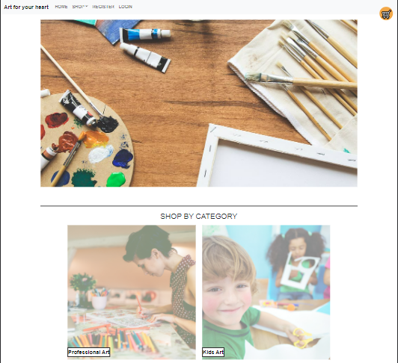

Slide 6
Directions for Future Development
Rating system
Customer Reviews/Comments
E-mail confirmation of order
Reminder for supply re-order
Search bar
Product favorites

Slide 7
Links
Deployed: https://final-project-drb.herokuapp.com/
GitHub repo: https://github.com/Brookethorson/final-project-1

